Slide 1



PIZZA SALES ANALYSIS
Presentation by Sagar Patil
Mentorness| 2024
Data Analyst Internship

Slide 2
INTRODUCTION
The goal of this SQL project is to analyze pizza sales data to gain insights into customer behavior, popular
pizza types, sales trends, and overall performance. The analysis will be performed using four tables:
order_details, orders, pizza_type, and pizza.
Presentation by Sagar Patil | Mentorness | 2024 | Data Analyst Internship

Slide 3

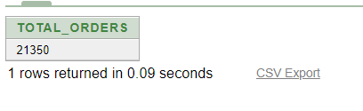

PROBLEM 1
The total number of order placed
SELECT COUNT(order_id) AS total_orders
FROM orders;
Presentation by Alexander Aronowitz | Business Marketing | 2024 | Rimberio University
Presentation by Sagar Patil | Mentorness | 2024 | Data Analyst Internship

Slide 4
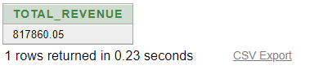
PROBLEM 2
The total revenue generated from pizza sales
SELECT SUM(od.quantity * p.price) AS total_revenue
FROM order_details od
JOIN pizzas p ON od.pizza_id = p.pizza_id
JOIN orders o ON od.order_id = o.order_id
JOIN pizza_types pt ON p.pizza_type_id = pt.pizza_type_id;
Presentation by Alexander Aronowitz | Business Marketing | 2024 | Rimberio University
Presentation by Sagar Patil | Mentorness | 2024 | Data Analyst Internship

Slide 5
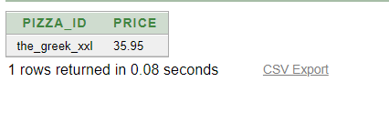
PROBLEM 3
The highest priced pizza.
SELECT pizza_id, price
FROM (
SELECT pizza_id, price
FROM pizzas
ORDER BY price DESC
)
WHERE ROWNUM = 1;
Presentation by Alexander Aronowitz | Business Marketing | 2024 | Rimberio University
Presentation by Sagar Patil | Mentorness | 2024 | Data Analyst Internship

Slide 6

PROBLEM 4
The most common pizza size ordered.
.
SELECT order_size, order_count FROM (
SELECT p.order_size, COUNT(od.pizza_id) AS order_count
FROM order_details od
JOIN pizzas p ON od.pizza_id = p.pizza_id
GROUP BY p.order_size
ORDER BY order_count DESC
) WHERE ROWNUM = 1;
Presentation by Alexander Aronowitz | Business Marketing | 2024 | Rimberio University
Presentation by Sagar Patil | Mentorness | 2024 | Data Analyst Internship

Slide 7
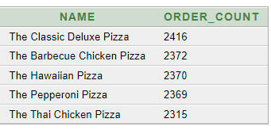
PROBLEM 5
The top 5 most ordered pizza types along their quantities.pizzas p
SELECT name, order_count
FROM (
SELECT pt.name, COUNT(od.pizza_id) AS order_count
FROM order_details od
JOIN pizzas p ON od.pizza_id = p.pizza_id
JOIN pizza_types pt ON p.pizza_type_id = pt.pizza_type_id
GROUP BY pt.name
ORDER BY order_count DESC
) sub
WHERE ROWNUM <= 5;
Presentation by Alexander Aronowitz | Business Marketing | 2024 | Rimberio University
Presentation by Sagar Patil | Mentorness | 2024 | Data Analyst Internship

Slide 8
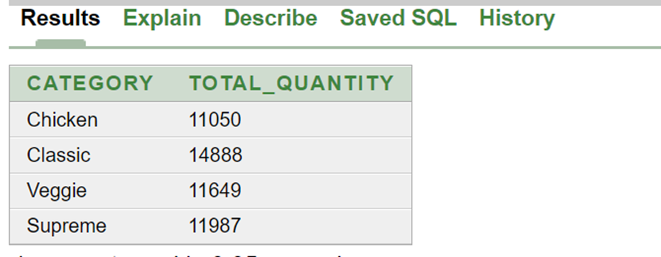
PROBLEM 6
The quantity of each pizza categories ordered.
SELECT pt.category, SUM(od.quantity) AS total_quantity
FROM order_details od
JOIN pizzas p ON od.pizza_id = p.pizza_id
JOIN pizza_types pt ON p.pizza_type_id = pt.pizza_type_id
GROUP BY pt.categor
Presentation by Alexander Aronowitz | Business Marketing | 2024 | Rimberio University
Presentation by Sagar Patil | Mentorness | 2024 | Data Analyst Internship

Slide 9
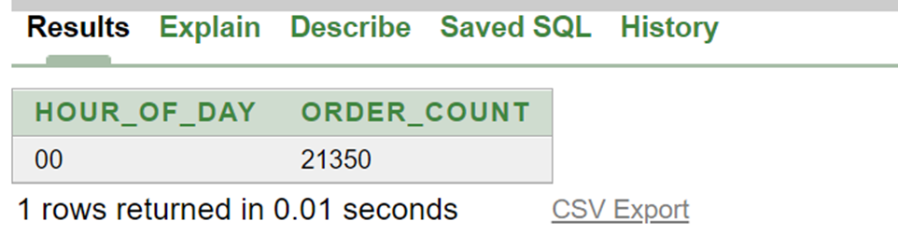
PROBLEM 7
The distribution of orders by hours of the day.
SELECT TO_CHAR(order_date, 'HH24') AS hour_of_day, COUNT(*) AS order_count
FROM orders
GROUP BY TO_CHAR(order_date, 'HH24')
ORDER BY hour_of_day;
Presentation by Alexander Aronowitz | Business Marketing | 2024 | Rimberio University
Presentation by Sagar Patil | Mentorness | 2024 | Data Analyst Internship

Slide 10
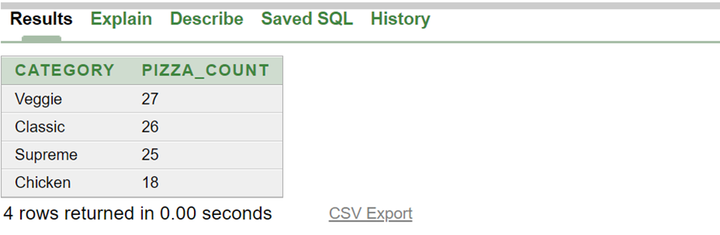
PROBLEM 8
The category-wise distribution of pizzas.
SELECT pt.category, COUNT(p.pizza_id) AS pizza_count
FROM pizzas p
JOIN pizza_types pt ON p.pizza_type_id = pt.pizza_type_id
GROUP BY pt.category
ORDER BY pizza_count DESC;
Presentation by Alexander Aronowitz | Business Marketing | 2024 | Rimberio University
Presentation by Sagar Patil | Mentorness | 2024 | Data Analyst Internship

Slide 11
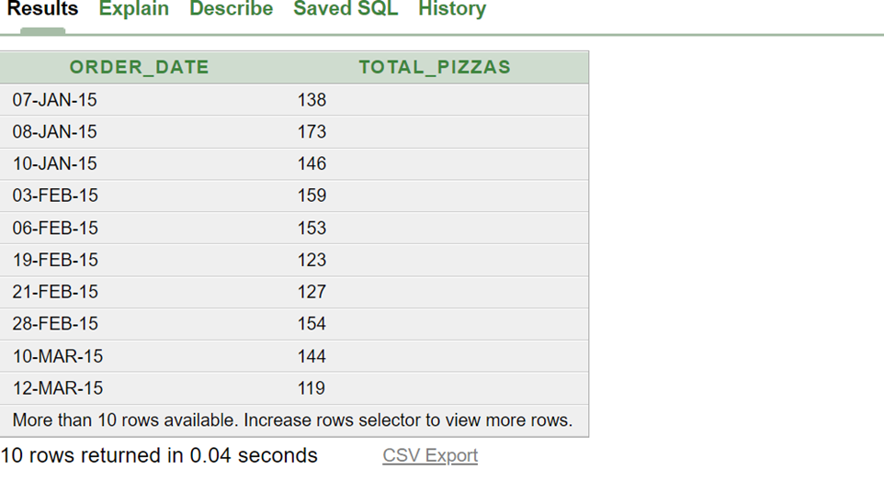
PROBLEM 9
The average number of pizzas ordered per day.
SELECT order_date, SUM(quantity) AS total_pizzas
FROM order_details od
JOIN orders o ON od.order_id = o.order_id
GROUP BY order_date;
Presentation by Alexander Aronowitz | Business Marketing | 2024 | Rimberio University
Presentation by Sagar Patil | Mentorness | 2024 | Data Analyst Internship

Slide 12
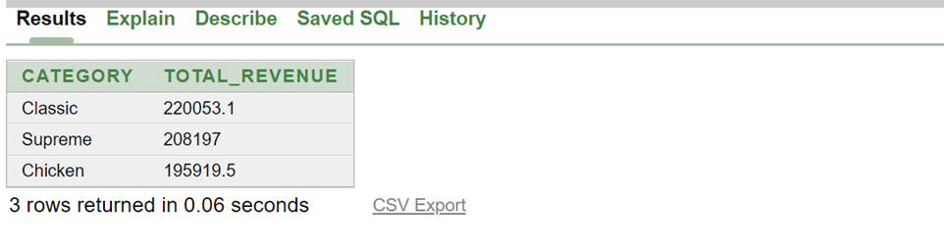
PROBLEM 10
Top 3 most ordered pizza type base on revenue.
SELECT category, total_revenue
FROM (
SELECT pt.category, SUM(p.price * od.quantity) AS total_revenue
FROM order_details od
JOIN pizzas p ON od.pizza_id = p.pizza_id
JOIN pizza_types pt ON p.pizza_type_id = pt.pizza_type_id
GROUP BY pt.category
ORDER BY total_revenue DESC
)
WHERE ROWNUM <= 3;
Presentation by Alexander Aronowitz | Business Marketing | 2024 | Rimberio University
Presentation by Sagar Patil | Mentorness | 2024 | Data Analyst Internship

Slide 13
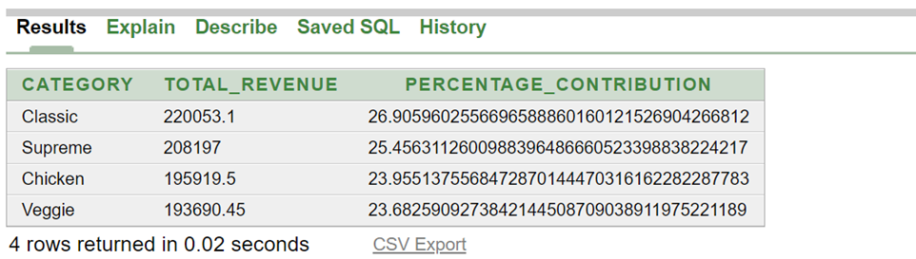
PROBLEM 11
The percentage contribution of each pizza type to revenue.
WITH RevenueByType AS (
SELECT pt.category,
SUM(p.price * od.quantity) AS total_revenue
FROM order_details od
JOIN pizzas p ON od.pizza_id = p.pizza_id
JOIN pizza_types pt ON p.pizza_type_id = pt.pizza_type_id
GROUP BY pt.category
),
TotalRevenue AS (
SELECT SUM(total_revenue) AS overall_revenue
FROM RevenueByType
)
SELECT rb.category,
rb.total_revenue,
(rb.total_revenue / tr.overall_revenue) * 100 AS percentage_contribution
FROM RevenueByType rb, TotalRevenue tr
ORDER BY percentage_contribution DESC;
Presentation by Alexander Aronowitz | Business Marketing | 2024 | Rimberio University
Presentation by Sagar Patil | Mentorness | 2024 | Data Analyst Internship

Slide 14
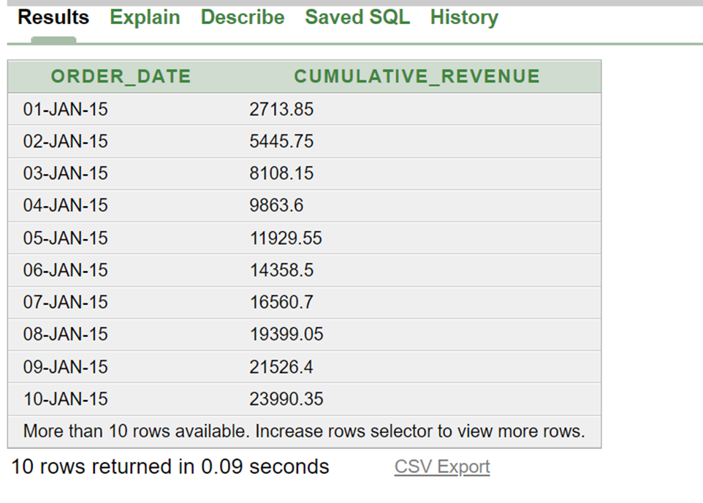
PROBLEM 12
The cumulative revenue generated over time
SELECT order_date,
SUM(total_revenue) OVER (ORDER BY order_date) AS cumulative_revenue
FROM (
SELECT o.order_date,
SUM(od.quantity * p.price) AS total_revenue
FROM order_details od
JOIN pizzas p ON od.pizza_id = p.pizza_id
JOIN orders o ON od.order_id = o.order_id
GROUP BY o.order_date
) t
ORDER BY order_date;
Presentation by Alexander Aronowitz | Business Marketing | 2024 | Rimberio University
Presentation by Sagar Patil | Mentorness | 2024 | Data Analyst Internship

Slide 15
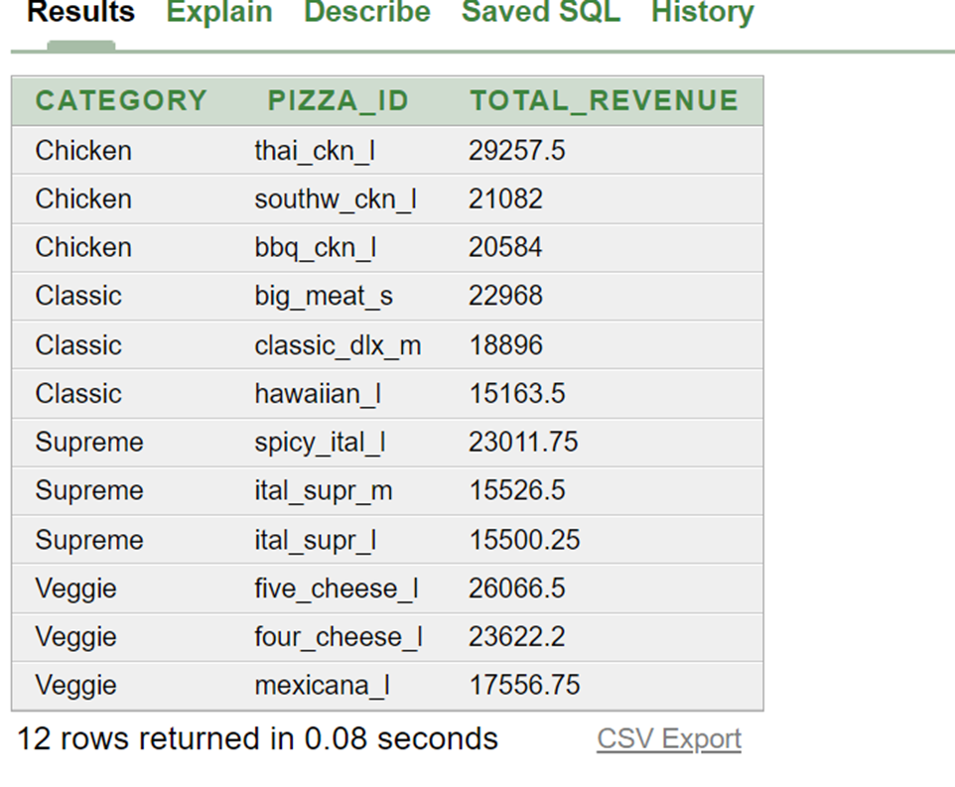
PROBLEM 13
The top 3 most ordered pizza type based on revenue for each pizza category.
WITH RevenueByType AS (
SELECT pt.category,
p.pizza_id, SUM(p.price * od.quantity) AS total_revenue
FROM order_details od
JOIN pizzas p ON od.pizza_id = p.pizza_id
JOIN pizza_types pt ON p.pizza_type_id = pt.pizza_type_id
GROUP BY pt.category, p.pizza_id),
RankedRevenue AS (
SELECT category,
pizza_id,
total_revenue,
RANK() OVER (PARTITION BY category ORDER BY total_revenue DESC) AS rank
FROM RevenueByType)
SELECT category,
pizza_id,
total_revenue
FROM RankedRevenue
WHERE rank <= 3
ORDER BY category, rank;
Presentation by Alexander Aronowitz | Business Marketing | 2024 | Rimberio University
Presentation by Sagar Patil | Mentorness | 2024 | Data Analyst Internship

Slide 16
THANK YOU
Presentation by Sagar Patil
Mentorness| 2024
Data Analyst Internship

